Slide 1
XP – Extreme Programming

Slide 2

What is Extreme Programming ?
XP is an agile engineering methodology, focused on delivering usable software iteratively in projects that are expected to change as time goes on. XP is geared toward integrating new requirements as they become known, and ensuring that the quality of the new code written to fulfill those requirements remains high.
XP takes commonsense principles and practices to extreme levels

Slide 3
What is difference between Scrum & XP?
Scrum is more high level, focusing on the management of the project (e.g. the requirements or features are managed) rather than specifying or defining engineering practice such as pair programming or test driven development
The length of an iteration in XP is usually 1-3 weeks whereas, in Scrum sprints are 2-4 weeks
Once sprint starts, customer cannot change the requirements, in other words the customer will have to wait until the sprint finishes. In XP however, requirements can change anytime
In XP features are developed in a strict order whereas in Scrum, the team is free to choose the features to be developed. Sequence does not matter
Both define the role of a coach, In Scrum it is called Scrum Master and requires (or strongly recommended) certification, whereas, XP defines the role of coach quite informally and the role may float between members of the team.
Scrum and XP are often used together: Scrum defines the framework and XP defines the engineering practices and they fit together nicely.
Notes:
Added taking reference from CSM material

Slide 4
XP Values
XP is based on 5 core values:
Simplicity - We will do what is needed and asked for, but no more. We will take small simple steps to our goal and mitigate failures as they happen.
Communication - Everyone is part of the team and we communicate face to face daily. We will work together on everything from requirements to code. We will create the best solution to our problem that we can together.
Feedback - We will take every iteration commitment seriously by delivering working software. We demonstrate our software early and often then listen carefully and make any changes needed.
Respect - Everyone gives and feels the respect they deserve as a valued team member. Everyone contributes value even if it's simply enthusiasm. Developers respect the expertise of the customers and vice versa.
Courage - We will tell the truth about progress and estimates. We don't document excuses for failure because we plan to succeed.

Slide 5
Rules of XP
Planning –
User stories are written.
Release planning creates the release schedule
Make frequent small releases
The project is divided into iterations
Iteration planning starts each iteration
Managing –
Give the team a dedicated open work space
Set a sustainable pace
A stand up meeting starts each day.
The Project Velocity is measured.
Move people around
Fix XP when it breaks.
Designing –
Simplicity
No functionality is added early
Refactor whenever and wherever possible.
Notes:
Above are the XP rules around basic Engg practises/activities followed in any development project
Keep the system uncluttered with extra stuff you guess will be used later. Extra functionality will always slow us down and squander our resources. Keeping your code ready for unexpected changes is about simple design. Adding extra flexibility beyond what you need now always makes a design more complex.

Slide 6
Rules of XP
Coding –
The customer is always available
Code must be written to agreed standards
Code the unit test first
All production code is pair programmed
Only one pair integrates code at a time
Integrate often
Set up a dedicated integration computer
Use collective ownership
Testing
All code must have unit tests
All code must pass all unit tests before it can be released.
Notes:
One of the few requirements of extreme programming (XP) is to have the customer available. Not only to help the development team, but to be a part of it as well. All phases of an XP project require communication with the customer, preferably face to face, on site. It's best to simply assign one or more customers to the development team.
You create one test to define some small aspect of the problem at hand. Then you create the simplest code that will make that test pass. Then you create a second test. Now you add to the code you just created to make this new test pass, but no more! Not until you have yet a third test. You continue until there is nothing left to test. The code you will create is simple and concise, implementing only the features you wanted

Slide 7
XP Process flow
User stories
values
Simple design
Spike solutions
acceptance test criteria
prototypes
Iteration Plan
Planning
Design
refactoring
Coding
Test
Release
(Software increment-
Pair
project velocity
Programming
computed)
Unit test
Continuous
Acceptance testing
integration

Slide 8
XP Roles
Customer
Writes User Stories and specifies Functional Tests
Sets priorities, explains stories
May or may not be an end-user
Has authority to decide questions about the stories
Programmer
Estimates stories
Defines Tasks from stories, and estimates
Implements Stories and Unit Tests
Coach
Watches everything, sends obscure signals, makes sure the project stays on course
Helps with anything
Tracker
Monitors Programmers’ progress, takes action if things seem to be going off track.
Actions include setting up a meeting with Customer, asking Coach or another Programmer to help

Slide 9
XP Roles contd
Tester
Implements and runs Functional Tests (not Unit Tests!)
Graphs results, and makes sure people know when test results decline.
Doomsayer
Ensures that everybody knows the risks involved
Ensures that bad news isn't hidden, glossed over, or blown out of proportion
Manager
Schedules meetings (e.g. Iteration Plan, Release Plan), makes sure the meeting process is followed, records results of meeting for future reporting, and passes to the Tracker
Possibly responsible to the Gold Owner.
Goes to meetings, brings back useful information
Pays for pizza
Gold Owner
The person funding the project, which may or may not be the same as the Customer

Slide 10
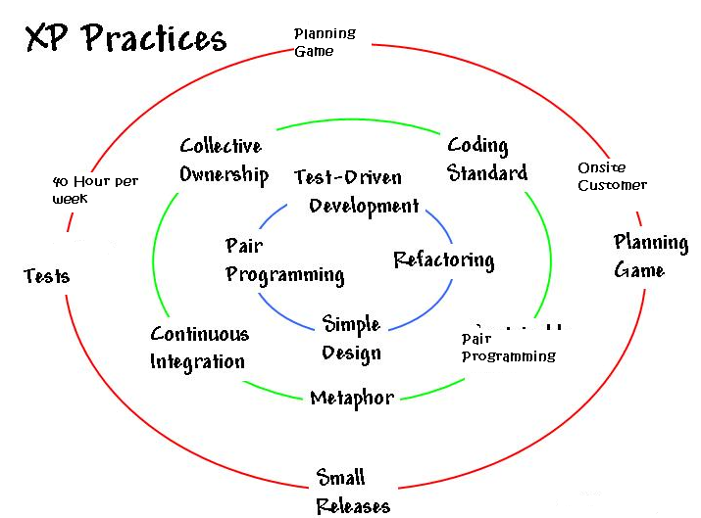
XP : 12 Practices
The Planning Game
Small Releases
Metaphor
Simple Design
Testing
Refactoring
Pair Programming
Collective ownership
Continuous integration
40-hour week
On-site customer
Coding standards
Notes:
The Planning Game — Quickly determine the scope of the next release by combining business priorities and technical estimates. As reality overtakes the plan, update the plan.
Small releases — Put a simple system into production quickly, then release new versions on a very short cycle.
Metaphor — Guide all development with a simple shared story of how the whole system works. Comparison of 2 unlikely things e.g. life is a journey.
Simple design — The system should be designed as simply as possible at any given moment. Extra complexity is removed as soon as it is discovered.
Testing — Programmers continually write unit tests, which must run flawlessly for development to continue. Customers write tests demonstrating that features are finished.
Refactoring — Programmers restructure the system without changing its behavior to remove duplication, improve communication, simplify, or add flexibility.
Pair programming — All production code is written with two programmers at one machine.
Collective ownership — Anyone can change any code anywhere in the system at any time.
Continuous integration — Integrate and build the system many times a day, every time a task is completed.
40 hour week — Work no more than 40 hours a week as a rule. Never work overtime a second week in a row.
On-site customer — Include a real, live user on the team, available full-time to answer questions.
Coding standards — Programmers write all code in accordance with rules emphasizing communication through the code.

Slide 11
XP Practices
The Planning Game
Quickly determine the scope of the next release by combining business priorities and technical estimates. As reality overtakes the plan, update the plan.
Small Releases
Every release must be as small as possible
Contain the most valuable business requirements
Release has to make sense
Collective ownership
Anyone can change any code anywhere in the system at any time.
Metaphor
Put a simple system into production quickly, then release new versions on a very short cycle.
Notes:
Though XP has 12 Practices, TechM has adopted 6 basic practices for Agile Implementation @ TechM and among the same practices have been explained in detail here. The most common practices followed are:
Small Releases
Continuous Integration
Refactoring
Coding Standards
Planning Game
Pair-Programming.
Pair-Programming is followed only when there are new members in the team so that they get on-the-job experience.

Slide 12
XP Practices
Pair programming
All production code is written with two programmers at one machine.
Continuous Integration
Code is integrated and tested after a few hours
Daily builds are for wimps
Build, end to end, at every check in
Check in frequently
Put resources on speeding build time
Put resources on speeding test time
Reduces project risk:
You’ll never spend days chasing a bug that was created some time in the last few weeks
Provides valuable human benefit during development
Notes:
Though XP has 12 Practices, TechM has adopted 6 basic practices for Agile Implementation @ TechM and among the same practices have been explained in detail here. The most common practices followed are:
Small Releases
Continuous Integration
Refactoring
Coding Standards
Planning Game
Pair-Programming.
Pair-Programming is followed only when there are new members in the team so that they get on-the-job experience.

Slide 13
XP Practices
Simple design
The system should be designed as simply as possible at any given moment. Extra complexity is removed as soon as it is discovered.
40 hour week
Work no more than 40 hours a week as a rule. Never work overtime a second week in a row.
Testing
Programmers continually write unit tests, which must run flawlessly for development to continue. Customers write tests demonstrating that features are finished.
On-site customer
Include a real, live user on the team, available full-time to answer questions.
Notes:
Though XP has 12 Practices, TechM has adopted 6 basic practices for Agile Implementation @ TechM and among the same practices have been explained in detail here. The most common practices followed are:
Small Releases
Continuous Integration
Refactoring
Coding Standards
Planning Game
Pair-Programming.
Pair-Programming is followed only when there are new members in the team so that they get on-the-job experience.

Slide 14
XP Practices
Refactoring
Refactoring is a disciplined technique for restructuring an existing body of code, altering its internal structure without changing its external behavior.
Meaning of word Factoring
2
x − 1 can be factored as (x − 1 ) (x + 1)
What have we done ? We have simplified further
In software refactoring it means
Rejuvenating old designs
Removing redundancy
Eliminating unused functionality
We cannot check in our code until:
All tests are green.
All duplication has been removed.
The code is as expressive as we can make it

Slide 15
XP Practices
Coding Standards
Consensus of coding style and practices
Contributes to definition of clean code and “doneness”
Goal is that code looks anonymous
All code should look the same
It should not possible to determine who coded what based on the code itself
Constraints
System should have the fewest possible classes
System should have the fewest possible methods
Comments should be minimized

Slide 16

Pair Programming
2 people work together at one PC to create a code for a story
One person types and thinks tactically about the method being created
Other thinks strategically about how that method fits into the class

Slide 17
Pair programming - Concerns
Productivity will be halved
With collective code ownership, it will be difficult for programmers to be recognized and compensated
It is annoying having someone looking over your shoulder while you program
Pair programming will interfere with "flow", which requires solitude and silence
But what has been observed …..

Slide 18
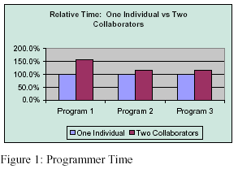
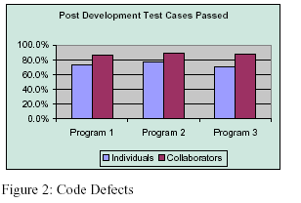
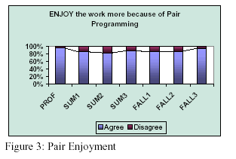
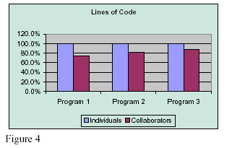
Pair programming – Success trends
Lesser than double Efforts
High Quality
People enjoy working in pairs
Lesser LOC

Slide 19
Pair programming-Take Care…

Slide 20
Stages of an XP project
Initiation
User Stories
Release Planning
Release (each Release is typically 1 - 6 months)
Iteration 1 (typically 1 - 3 weeks)
Development
Deployment
Acceptance Testing
Iteration 2
Development
Deployment
Acceptance Testing
- Iteration n

Slide 21
Advantages of XP
Customer focus increases the chance that the software produced will actually meet the needs of the users
The focus on small, incremental release decreases the risk on your project: by showing that your approach works and by putting functionality in the hands of your users, enabling them to provide timely feedback regarding your work.
Continuous testing and integration helps to increase the quality of your work
XP is attractive to programmers who normally are unwilling to adopt a software process, enabling your organization to manage its software efforts better.

Slide 22
Disadvantages of XP
XP is particularly vulnerable to "bad apple" developers who:
don't work well with others
who think they know it all, and/or
who are not willing to share their "superior” code
XP will not work in an environment where a customer or manager insists on a complete specification or design before they begin programming.
XP will not work in an environment where programmers are separated geographically.
XP has not been proven to work with systems that have scalability issues (new applications must integrate into existing systems).

Slide 23


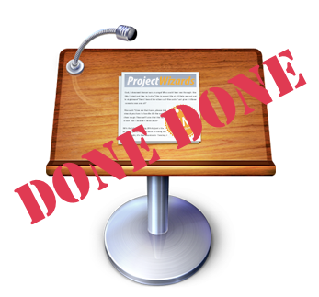
Definition of DONE (DoD)
Manager – Is the feature you were working on “done”?
Developer - “Yes” ..I checked in the code and had unit tested it…so its “done” from my side.
Manager - Great, then we will go ahead and deploy it into the UAT environment
Developer- But it has not been fully tested by QA, and still need to pass a code review
Manager- Well…….that means its not DONE…..
Root Cause of above “very common ” scenario in Scrum is – there is no common, clear, discussed, agreed upon definition of “Done” for a sprint within the scrum team.

Slide 24

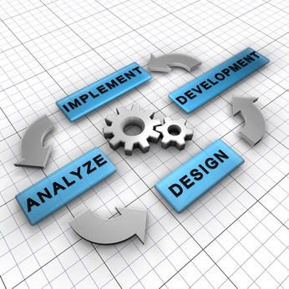
Definition of DONE (DoD)
Definition of DONE (DoD)
Definition of done (DoD) captures activities, that can be realistically committed by the team, to be completed at each level (feature, sprint, release)
DoD is a checklist of valuable activities required to produce software in each sprint
Ideally, potentially shippable is equivalent to the Definition of Done
DoD is orthogonal to user acceptance criteria for a feature
DoD is the primary reporting mechanism for team members.
The DoD is used to validate whether all major tasks are accounted for
Different DoD at various levels:
DoD for a feature (story or product backlog item)
DoD for a sprint (collection of features developed
within a sprint)
DoD for a release (potentially shippable state)

Slide 25
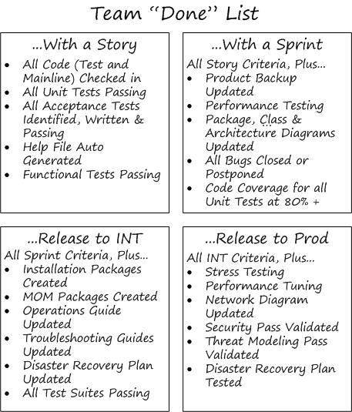
Examples of DoD

